Slide 1
Documentation
PowerPoint presentation
Unit 304: Electrical Installations: inspection, testing and commissioning

Slide 2
Documentation
Purpose of certification documentation
On completion and during its life it is important that documentation and certification be produced for an electrical installation for a number of reasons including:
a record of the extent and suitability of the installation for use
retention for seller’s/purchase information if the property is to be sold at a later date
future inspection and testing purposes
for landlord’s purposes if the property is to be let.

Slide 3
Documentation
Signatories
Person(s) responsible for design
Person responsible for construction
Person responsible for inspection.

Slide 4
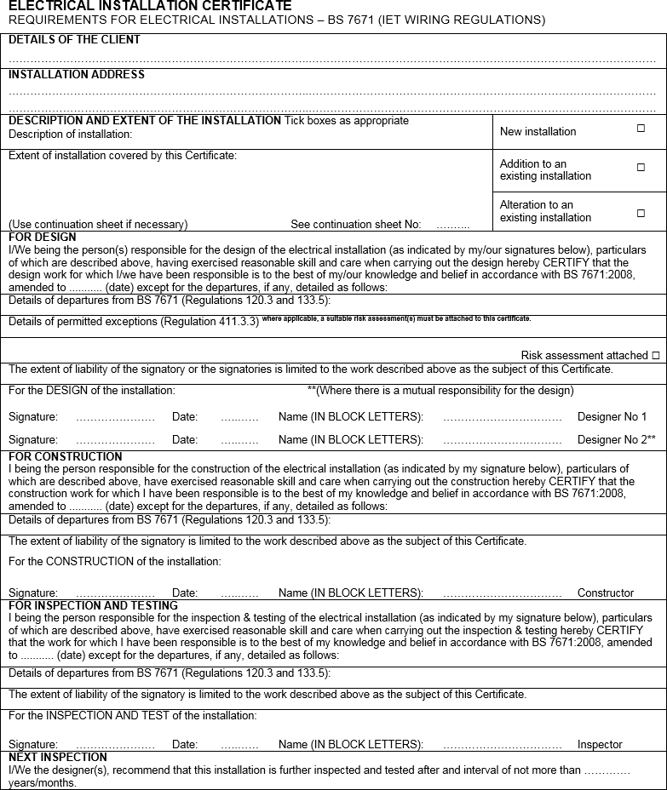
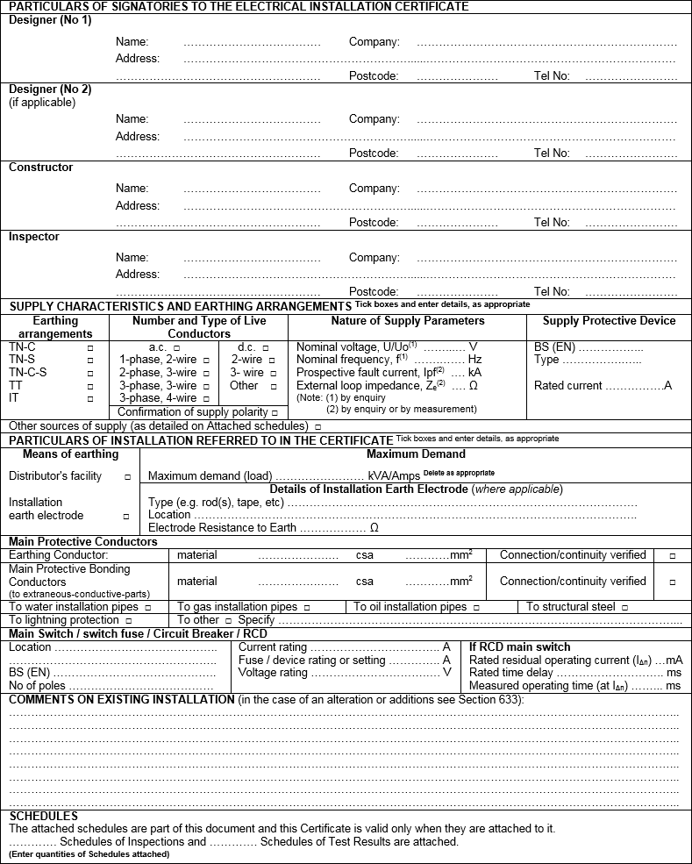
Electrical installation certificate

Slide 5
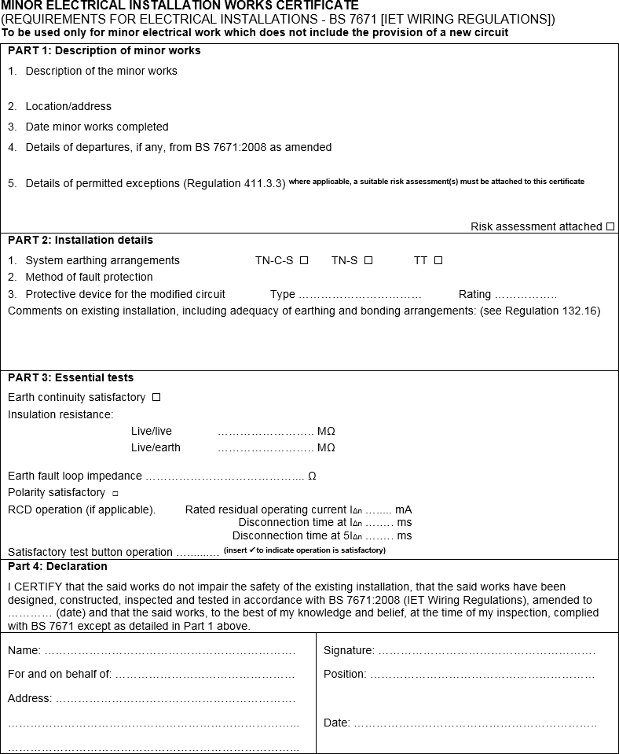
Minor Electrical Installation Works Certificate

Slide 6
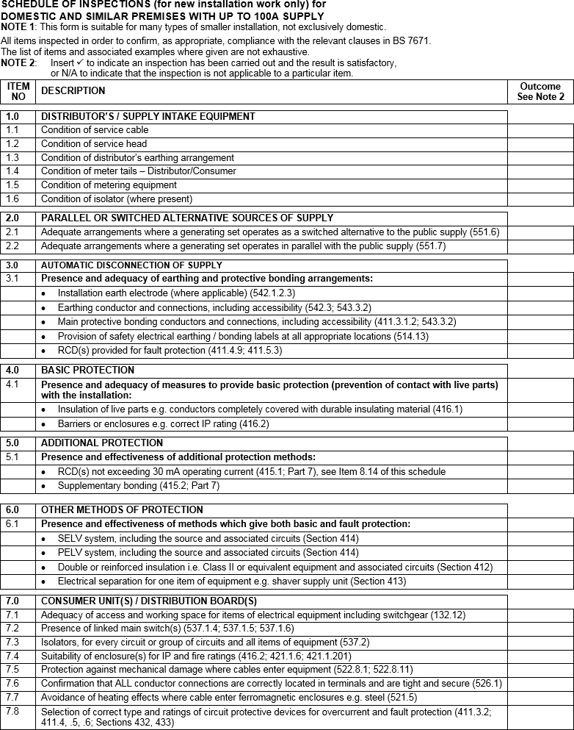
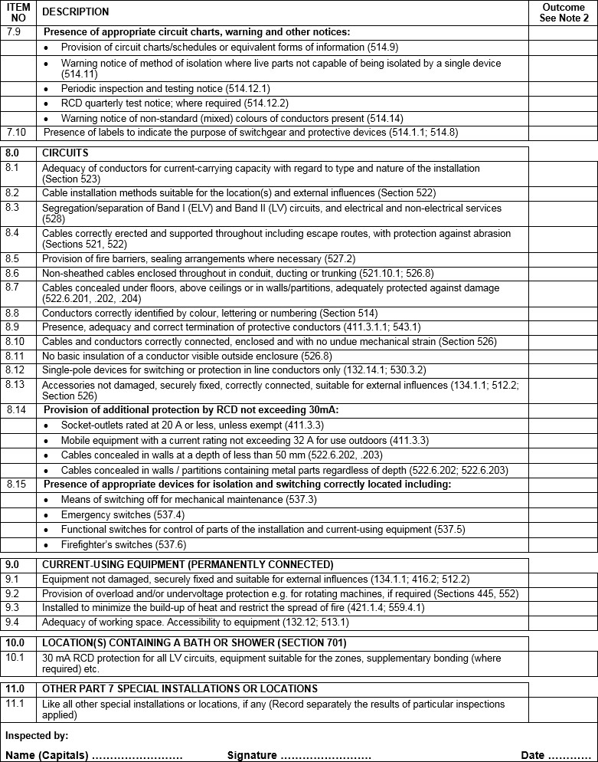
Schedule of inspections

Slide 7
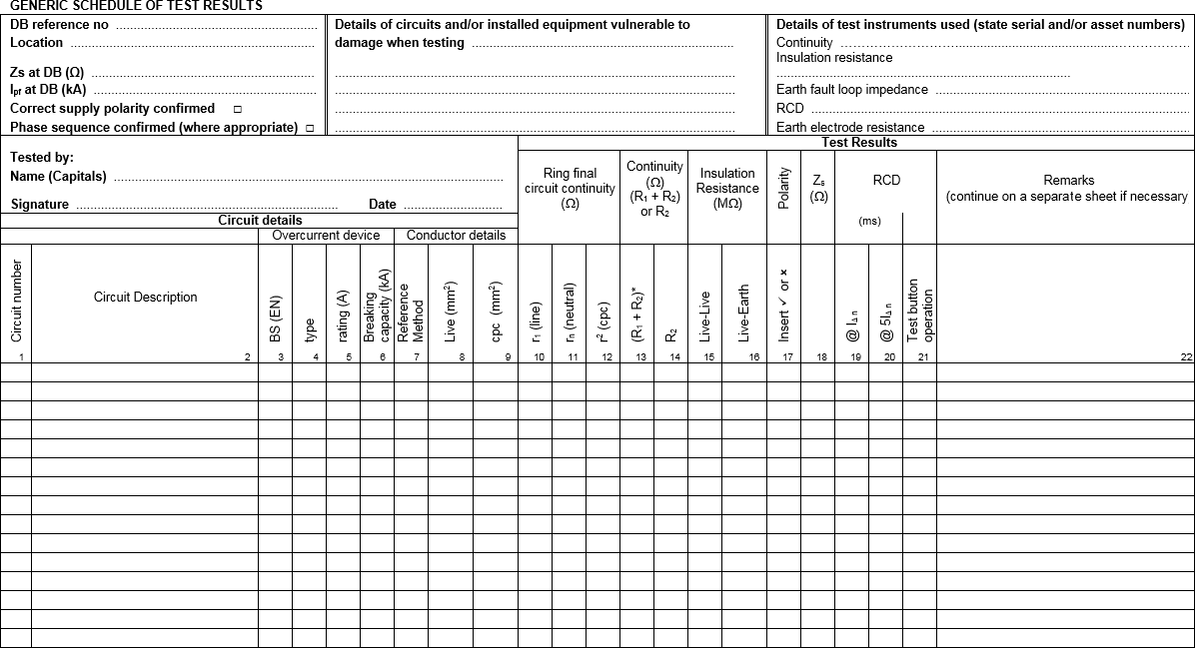
Schedule of test results

Slide 8
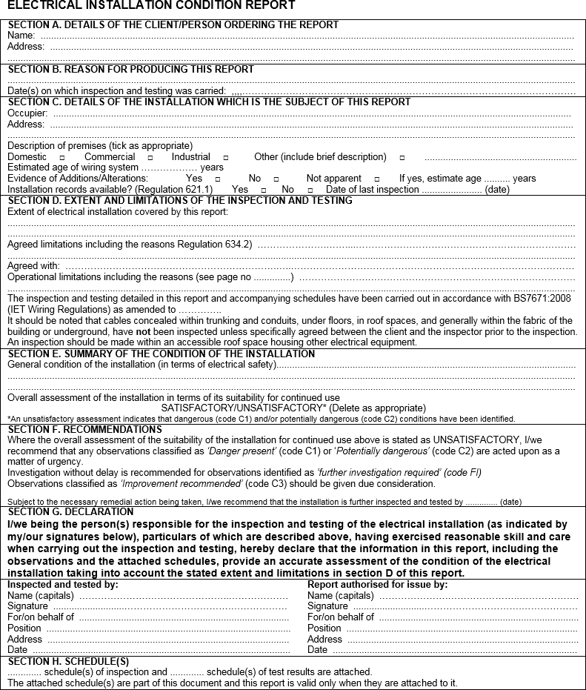
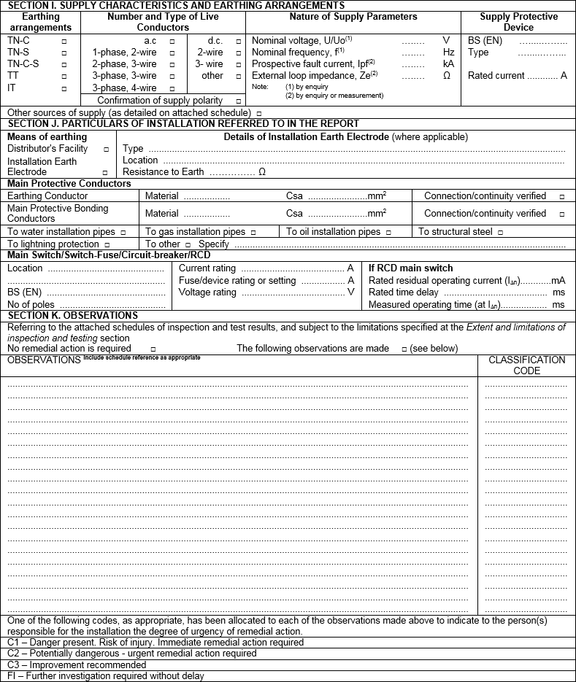
Electrical installation condition report

Slide 9
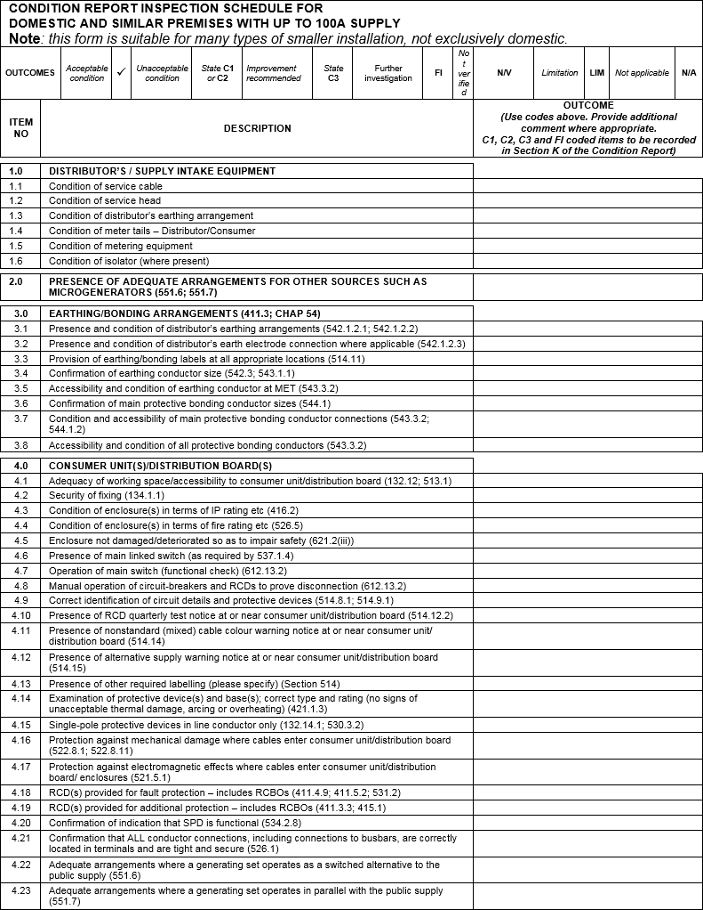
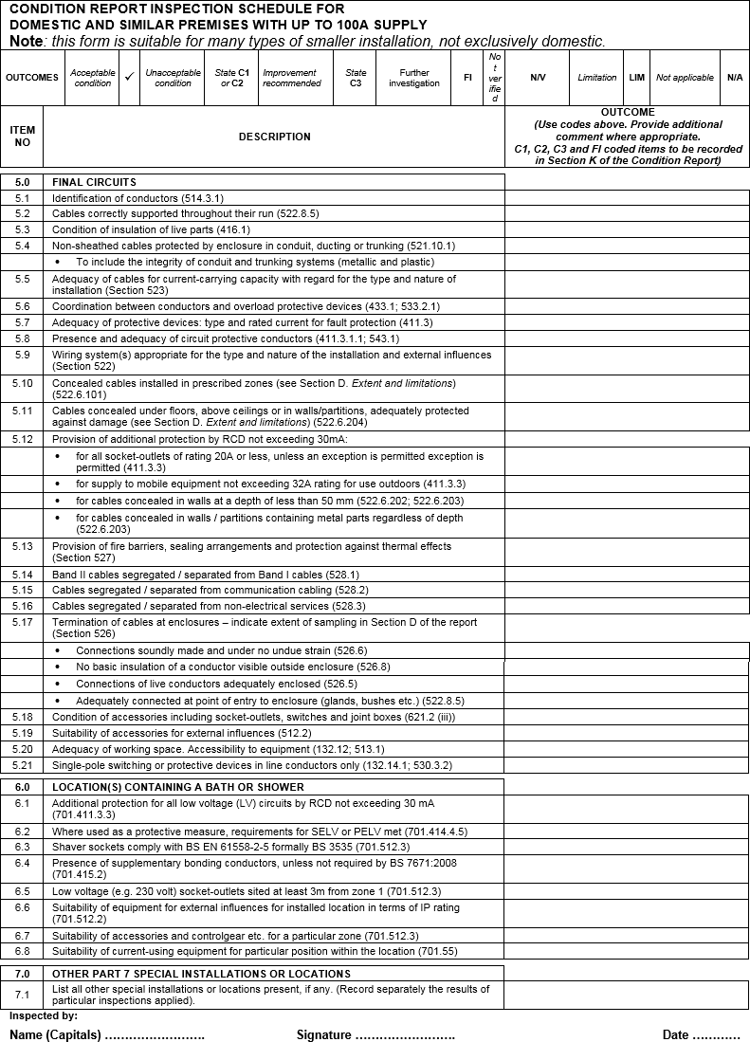
Electrical installation condition report – domestic

Slide 10
Any questions?

